Slide 1



PlayWise
Software Dependability
Francesco Maria Torino 0522501879
f.torino1@studenti.unisa.it

Slide 2


Overview
PlayWise Overview
PlayWise is a platform designed to:
Offer a wide catalog of video games and an active user community
Allow people to share impressions with other users on the platform
PlayWise
Francesco Maria Torino
SwD Project
f.torino1@studenti.unisa.it

Slide 3


Overview
PlayWise Transformation
PlayWise
Francesco Maria Torino
SwD Project
f.torino1@studenti.unisa.it

Slide 4
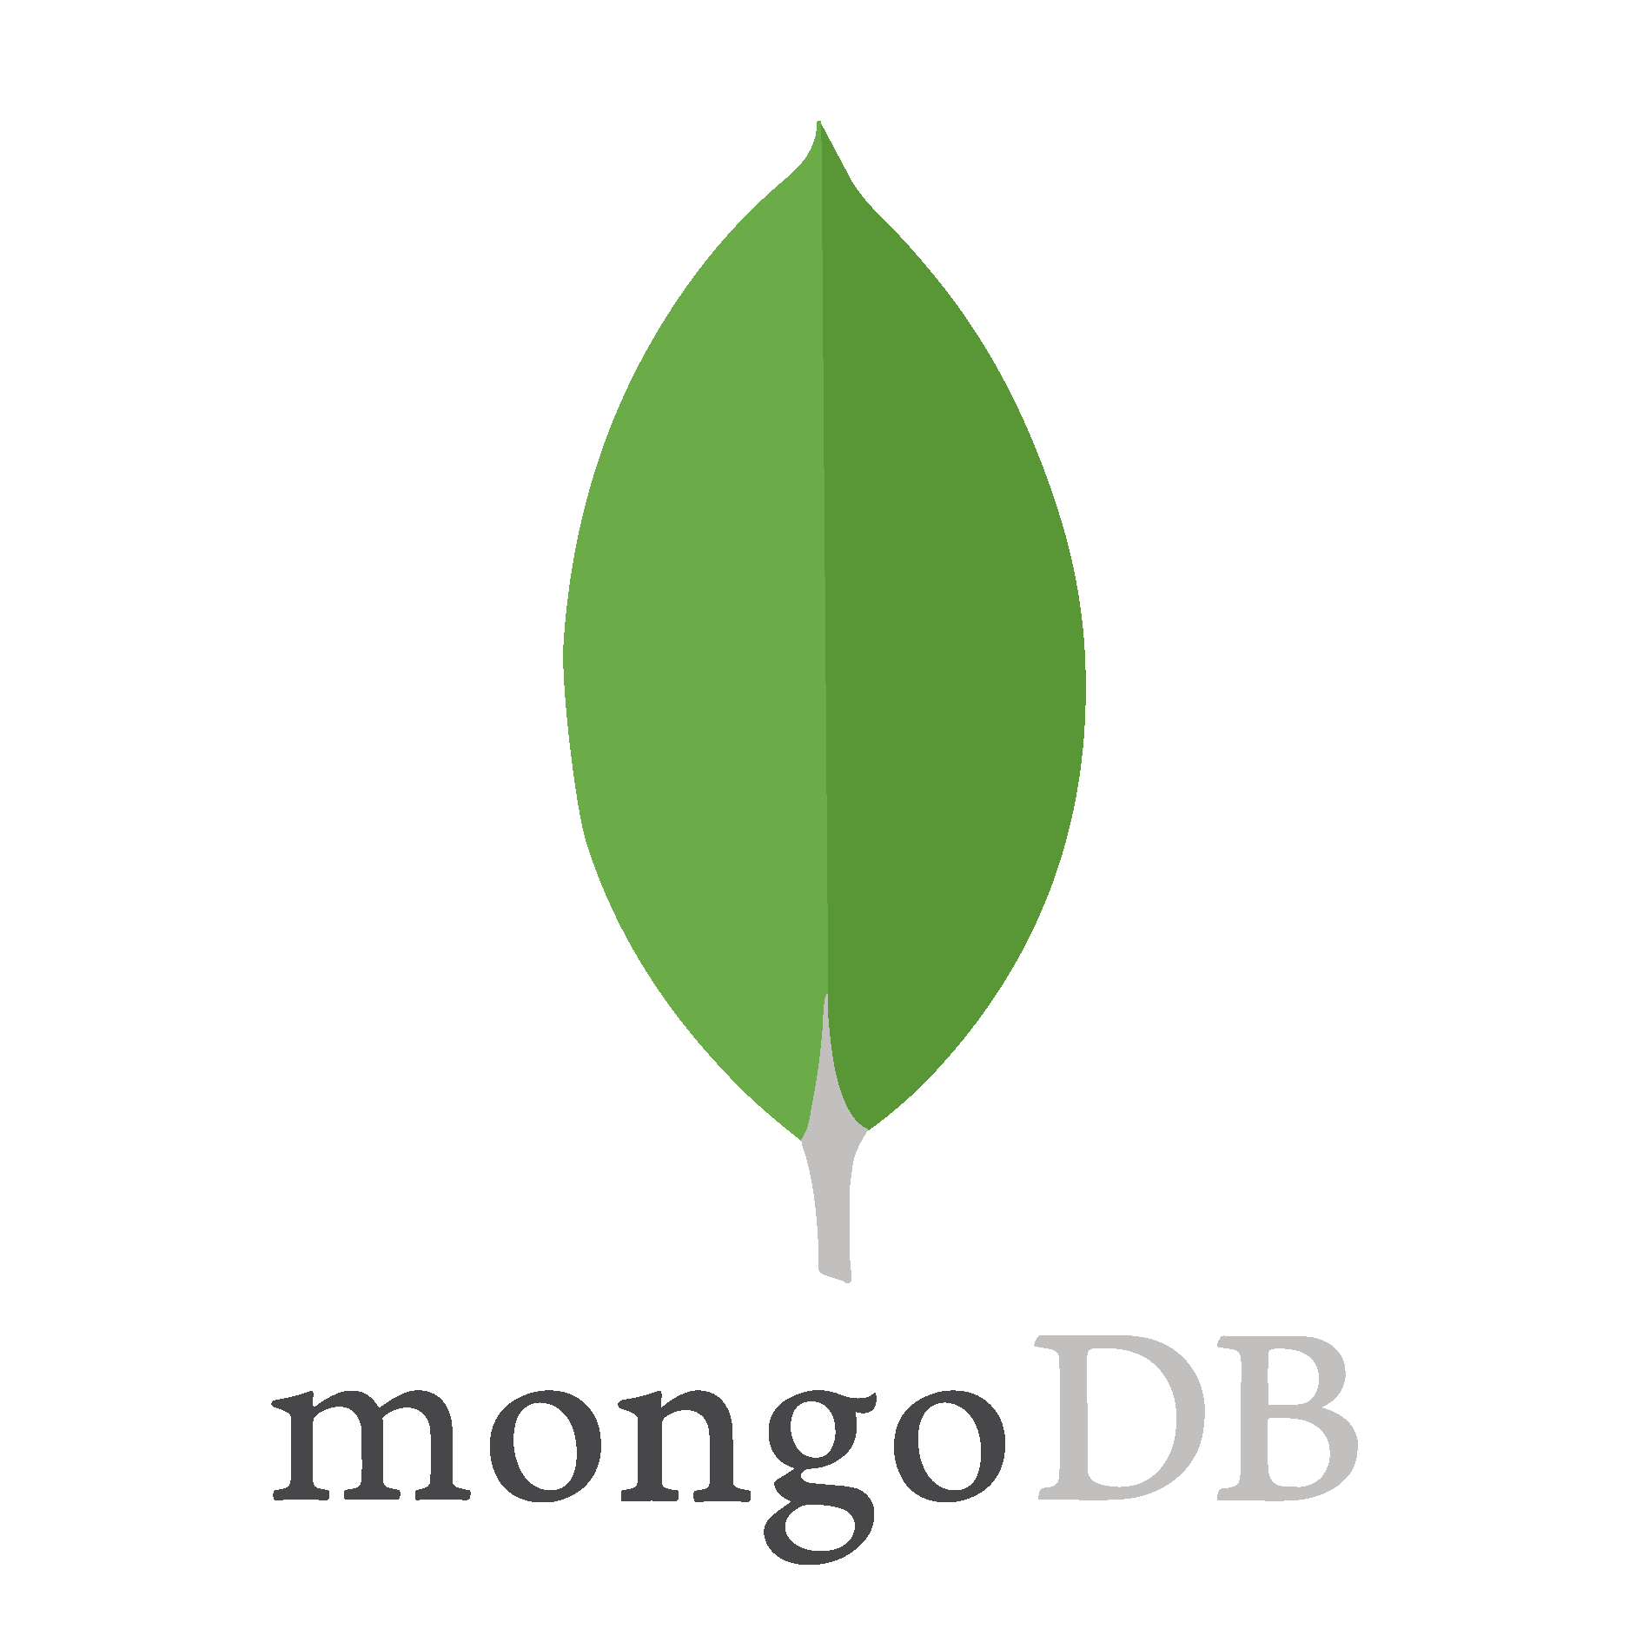


Overview
PlayWise Technologies
PlayWise
Francesco Maria Torino
SwD Project
f.torino1@studenti.unisa.it

Slide 5


Overview
PEGI classifier
PlayWise
Francesco Maria Torino
SwD Project
f.torino1@studenti.unisa.it

Slide 6

Overview
Project’s goals
With the application of software dependability concepts, we want to introduce:
Reliability
Security
Performance Reliability
Availability
PlayWise
Francesco Maria Torino
SwD Project
f.torino1@studenti.unisa.it

Slide 7

Reliability
To ensure system correctness and stability.
Formal Verification
Code Coverage
(Test with ChatGPT)
Mutation testing
OpenJML
100%
100%
Static (ESC) and dynamic (RAC) verification successfully completed on the critical GeneticEngine module.
Reached 100% Line and Branch coverage with JaCoCo on Controller, Service, and Utility modules.
Zero surviving mutants with PITest. A robust test suite against logical faults.
PlayWise
Francesco Maria Torino
SwD Project
f.torino1@studenti.unisa.it

Slide 8





Security
To detect vulnerabilities and dependency risks.
Secret detection
Vulnerability scan
Code quality
Dependency updates
GitGuardian
Snyk
SonarCloud
DependaBot
Detects exposed secrets and credentials in the repository, preventing accidental .
Scans project dependencies and configurations to identify and fix known security vulnerabilities.
Performs static code analysis to detect bugs, code smells, and security hotspots, improving overall code quality.
Automatically monitors and updates vulnerable or outdated dependencies to maintain a secure software supply chain.
PlayWise
Francesco Maria Torino
SwD Project
f.torino1@studenti.unisa.it

Slide 9



Performance Reliability
To measure efficiency and performance stability.
Test analytics
Microbenchmarking
CodeCov
JMH
Collects coverage and test execution metrics to identify untested code paths and performance-critical tests.
Measures execution time and performance of critical methods in isolation, enabling targeted optimizations.
PlayWise
Francesco Maria Torino
SwD Project
f.torino1@studenti.unisa.it

Slide 10
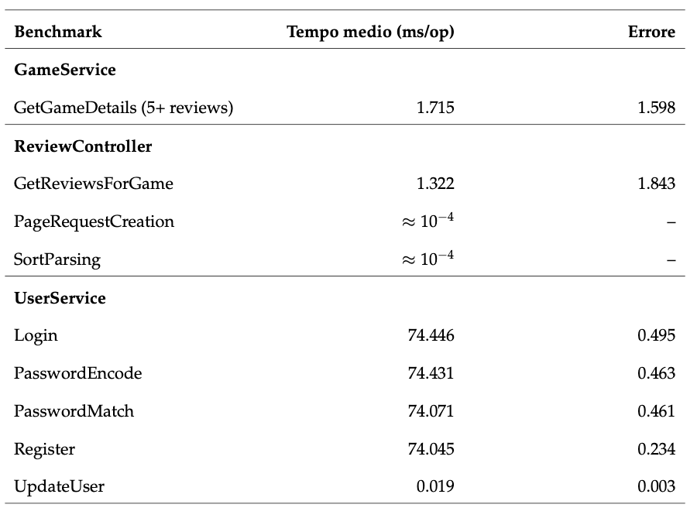
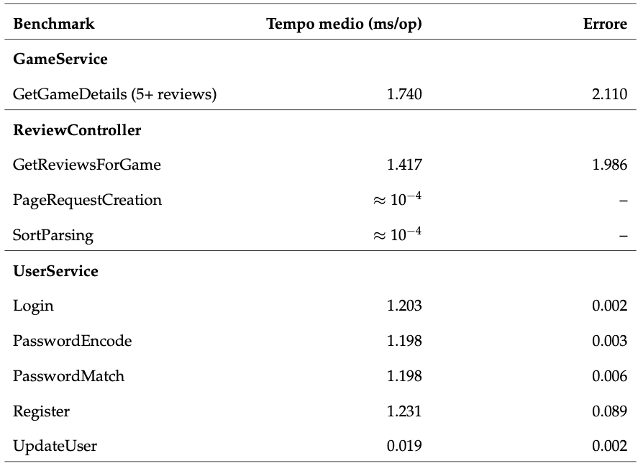
Performance Reliability
PlayWise
Francesco Maria Torino
SwD Project
f.torino1@studenti.unisa.it

Slide 11



Avaliability
To ensure continuous and automated service operation.
Dockerization
CI/CD
DockerHub
GitHub Actions
Published on DockerHub to guarantee reproducible deployment and high availability.
CI/CD automates build, testing, and deployment to ensure continuous availability and reliability.
PlayWise
Francesco Maria Torino
SwD Project
f.torino1@studenti.unisa.it

Slide 12
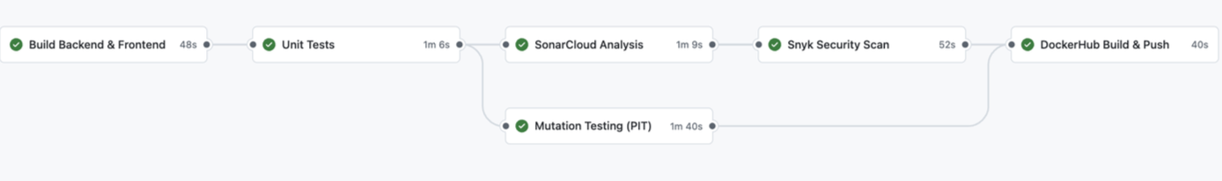
Avaliability
PlayWise
Francesco Maria Torino
SwD Project
f.torino1@studenti.unisa.it

Slide 13

PlayWise
Software Dependability
Francesco Maria Torino f.torino1@studenti.unisa.it

